Slide 1
SARS-CoV-2 sequence submission & annotation
The National Center for Biotechnology Information (NCBI)
Linda Yankie and Eric Nawrocki
Oct. 21st 2020

Slide 2
Overview
Goals/why we’re here
VADR for annotation
GenBank submission examples
Trends & other tips
Programmatic submission
Submission roadmap
Suggestions from this community
Engagement opportunities
Q&A

Slide 3
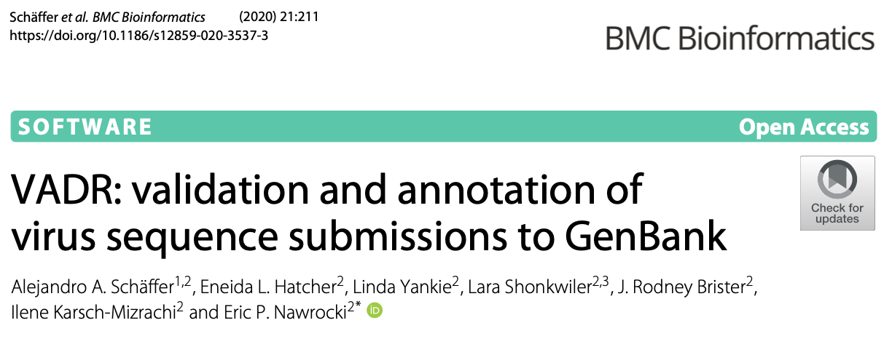
VADR: Viral Annotation DefineR
a general tool for reference-based annotation of viral sequences
aligns sequences globally with respect to a RefSeq or profile
originally designed for dengue virus and norovirus but used for SARS-CoV-2 since March 2020

Slide 4
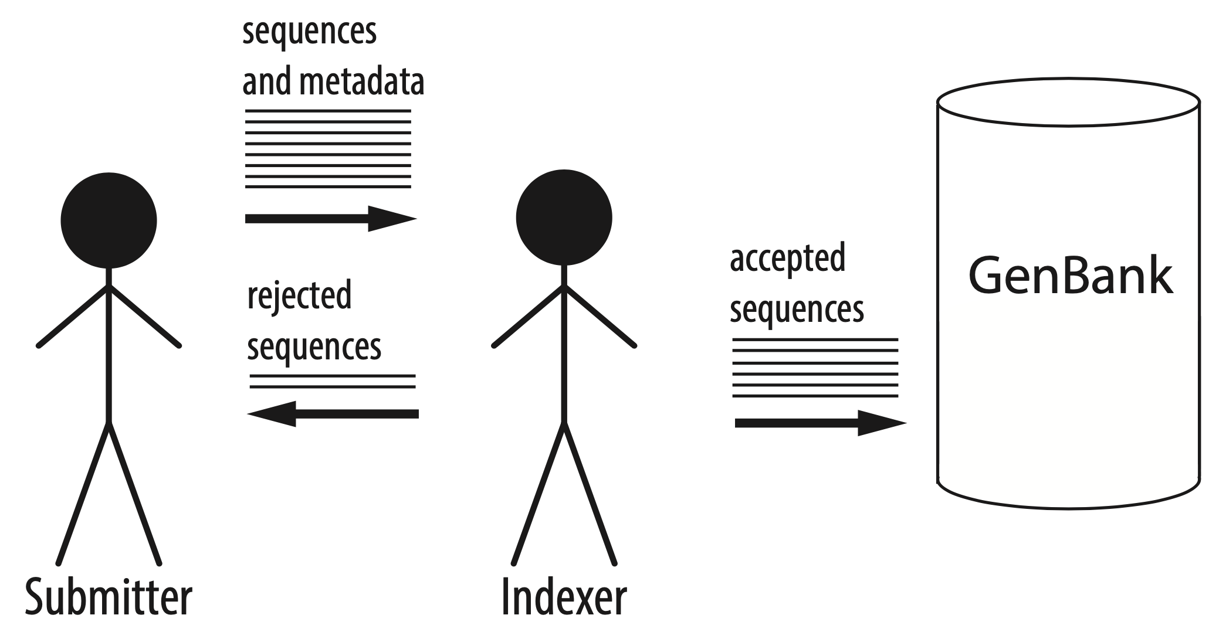
GenBank indexers handle incoming sequence submissions

Slide 5
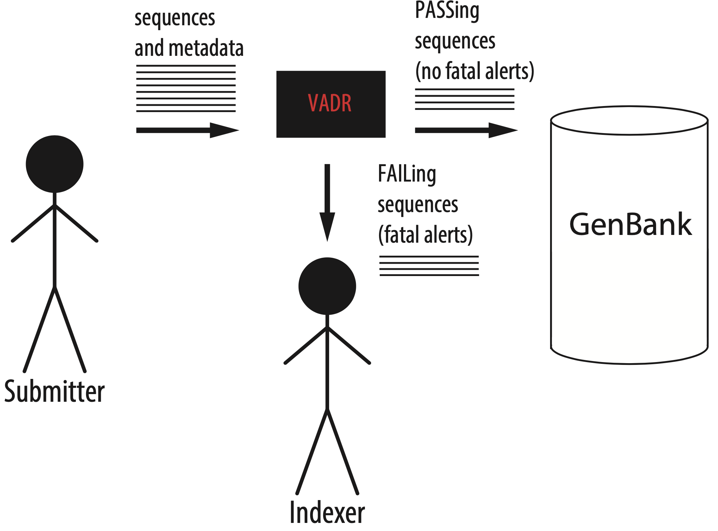
VADR assists GenBank indexers: each sequence PASSes or FAILs

Slide 6
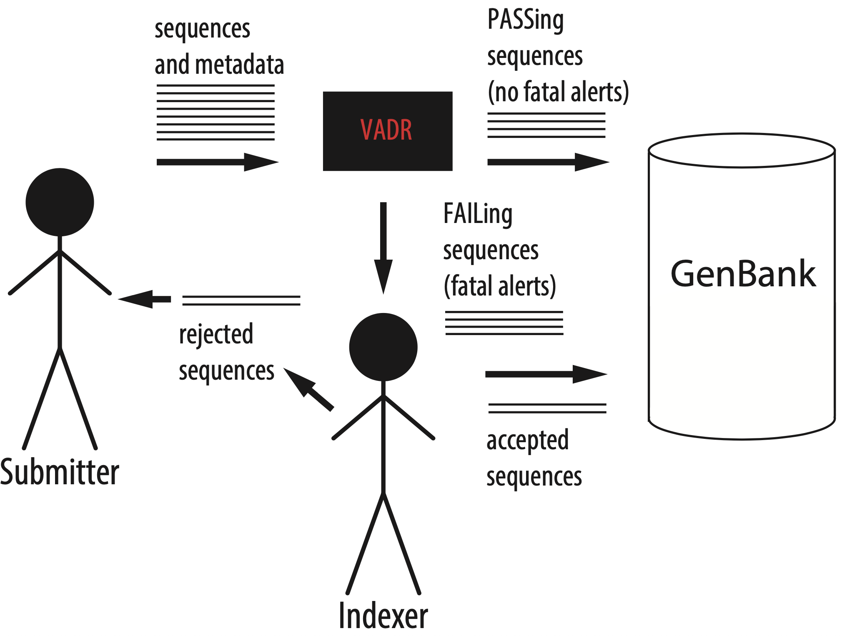
Indexers decide fate of FAILed sequences

Slide 7
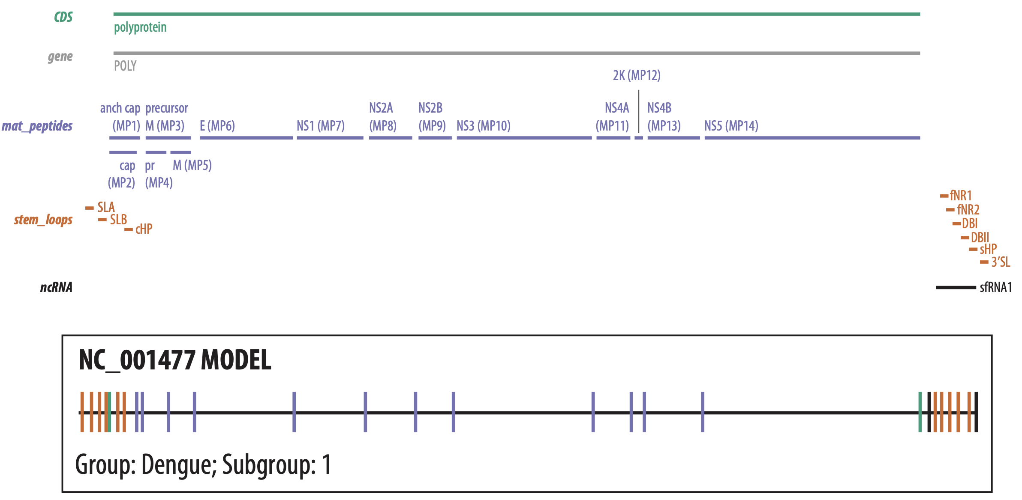
VADR builds a homology model (covariance model (CM)) of a RefSeq and stores feature information

Slide 8
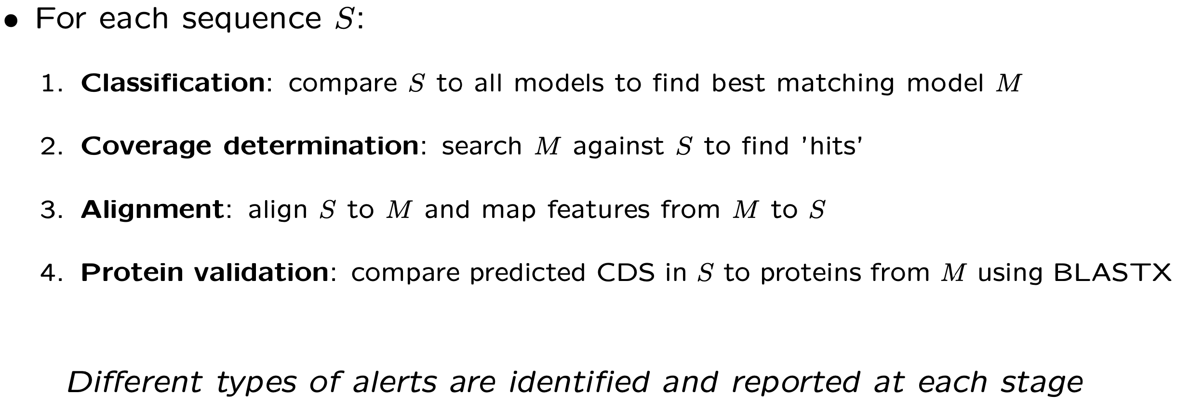
VADR annotates each sequence with features from its best matching model

Slide 9
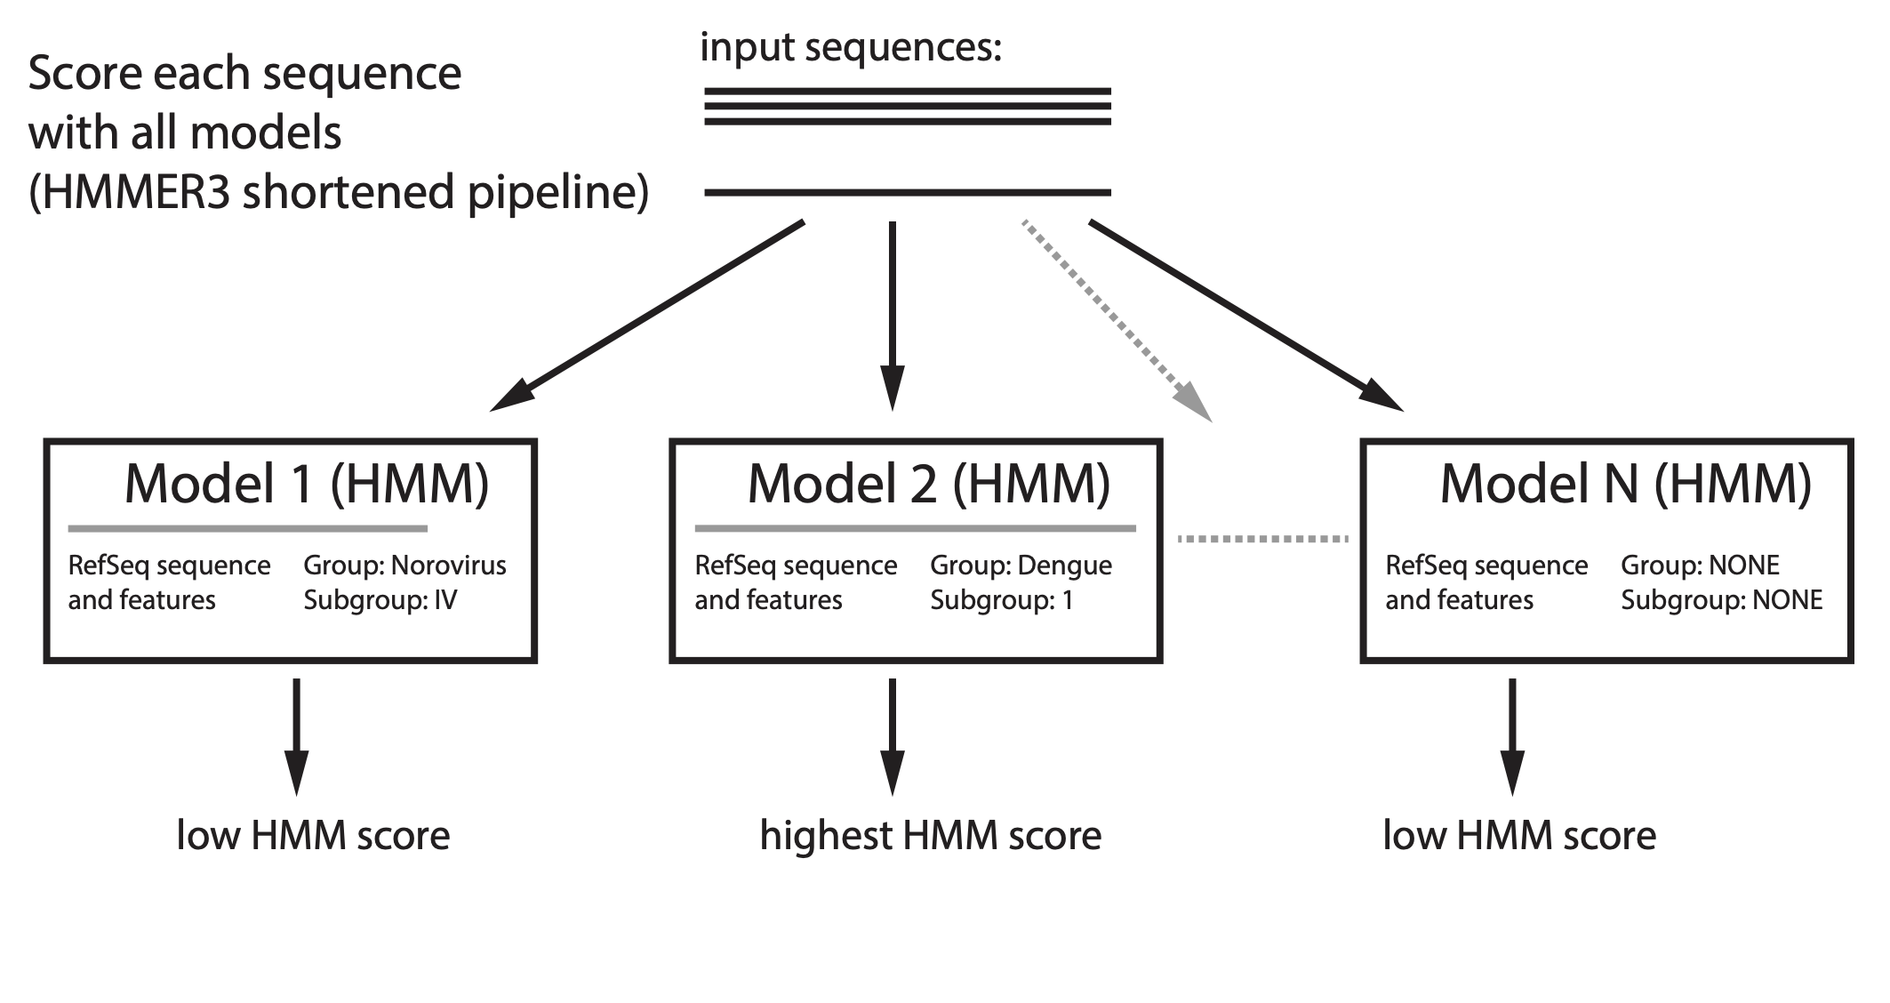
Stage 1: Classification

Slide 10
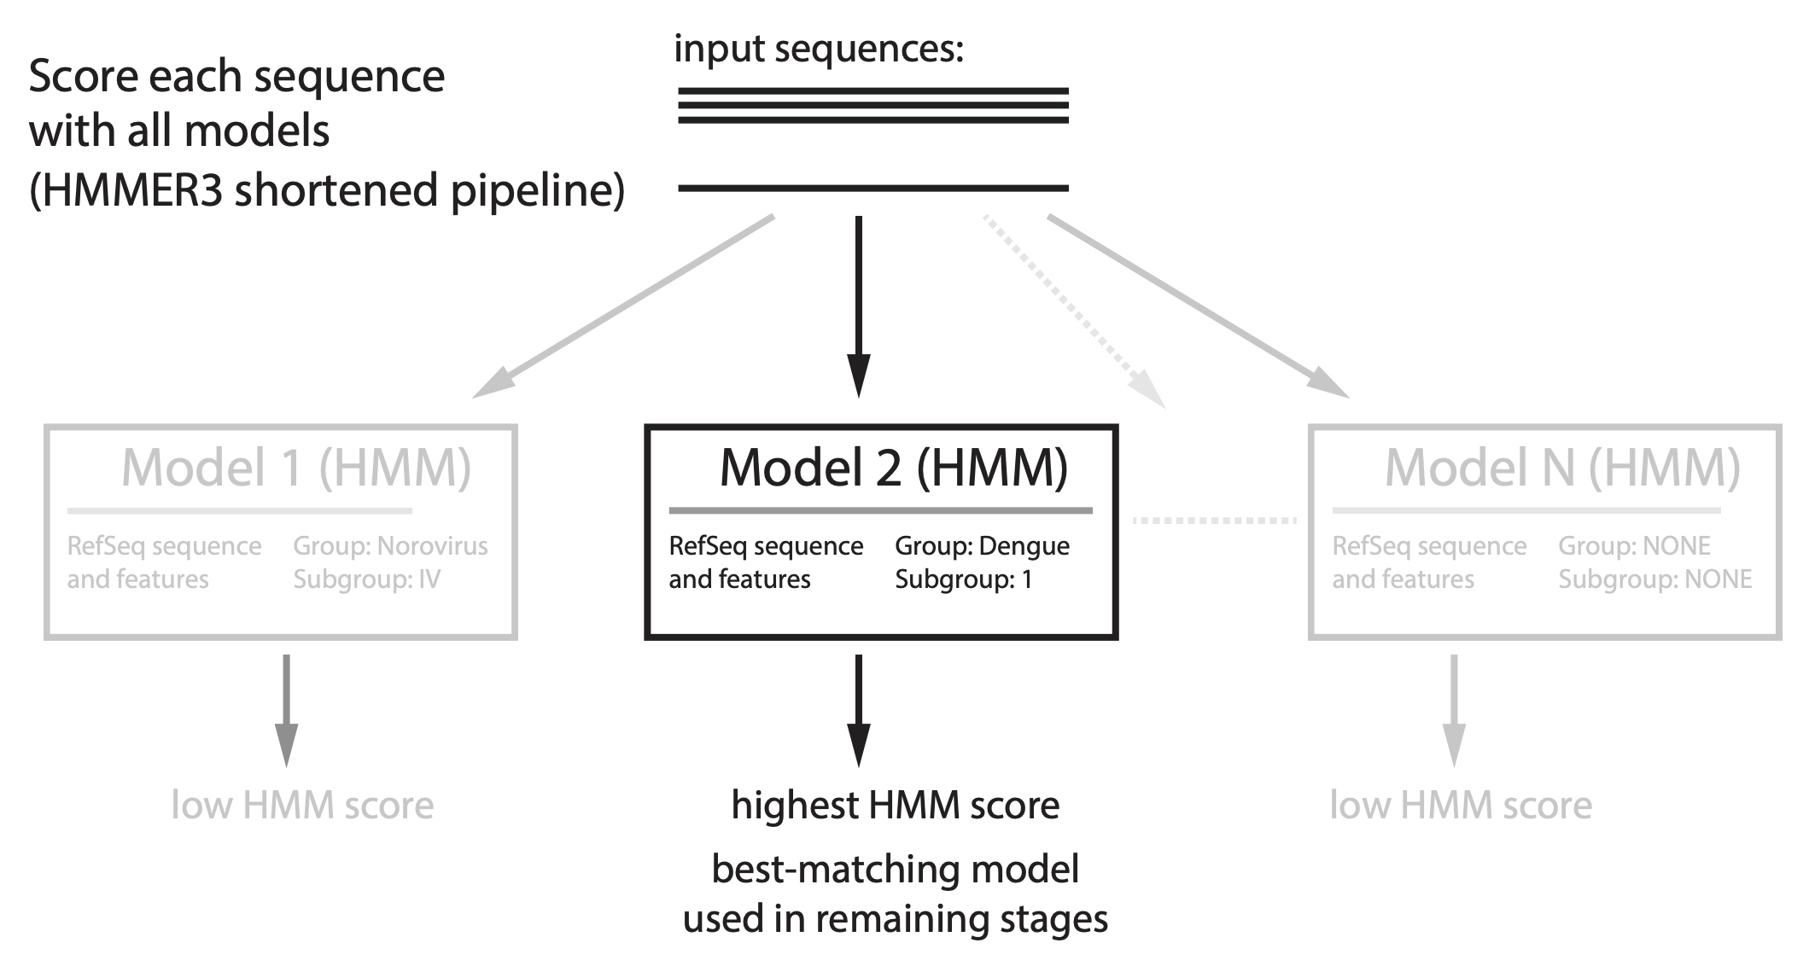
Stage 1: Classification

Slide 11
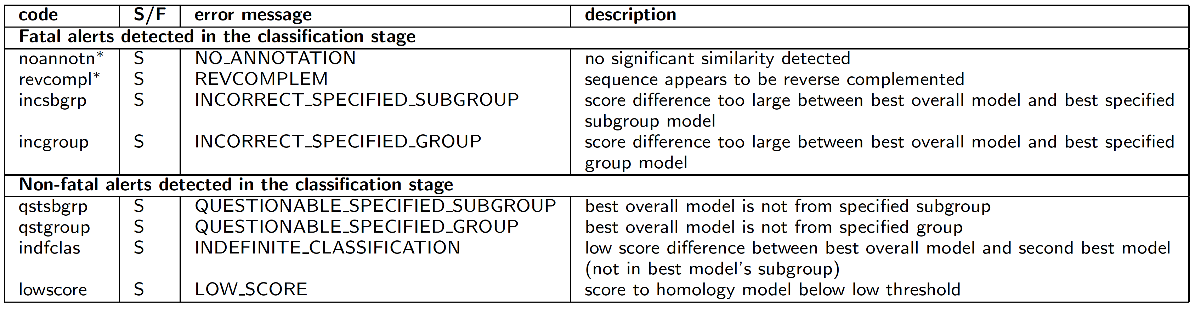
Alerts reported in classification stage

Slide 12
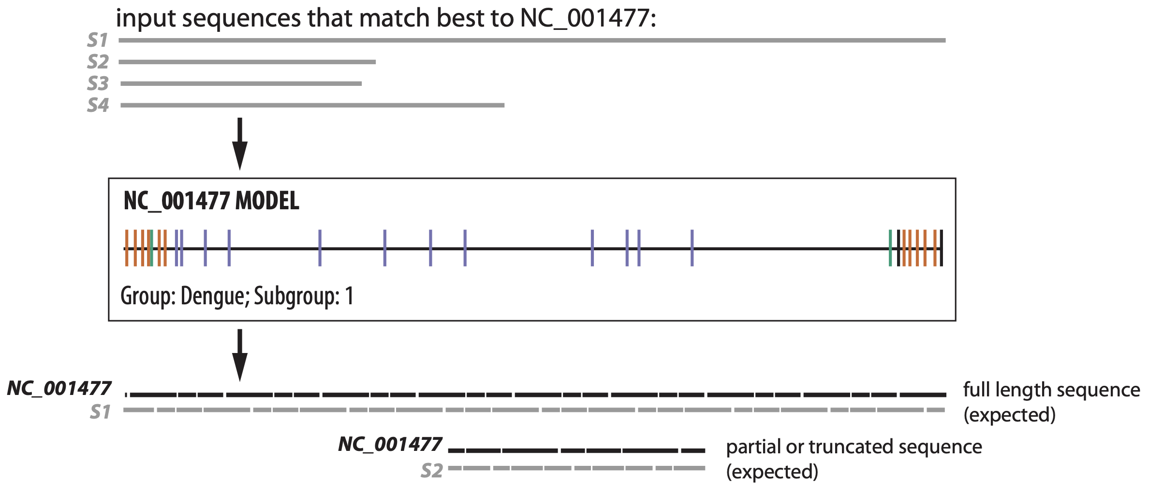
Stage 2: Coverage determination
Search each sequence with best-matching model (HMMER3 full pipeline)

Slide 13
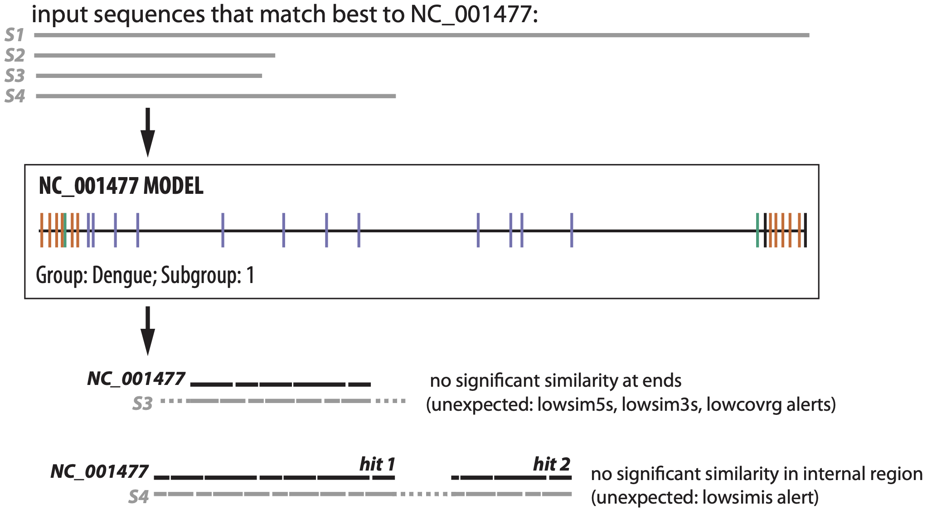
Stage 2: Coverage determination
Search each sequence with best-matching model (HMMER3 full pipeline)

Slide 14
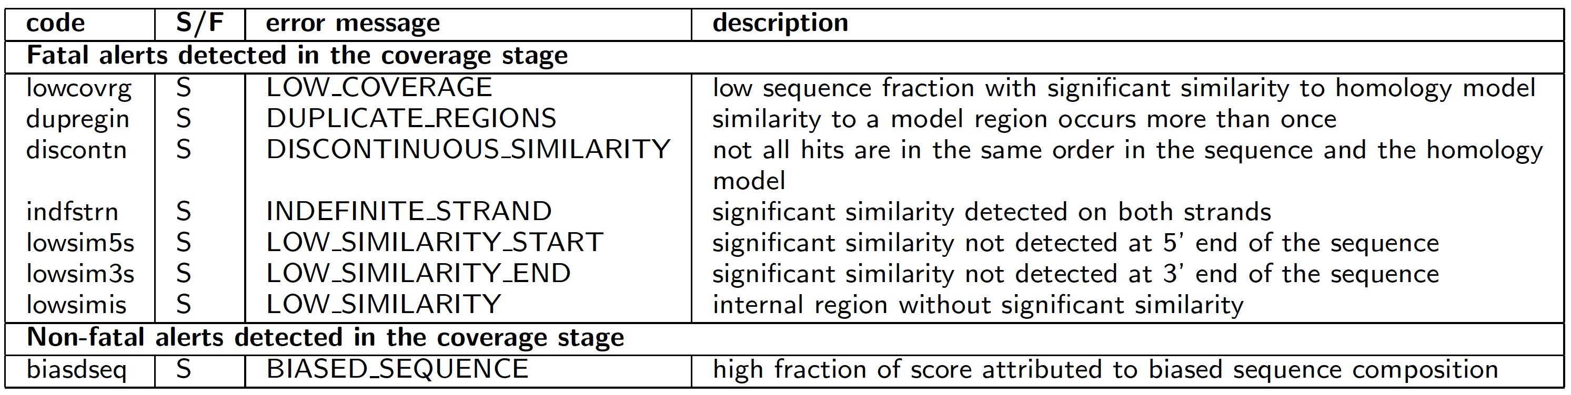
Alerts reported in coverage determination stage

Slide 15
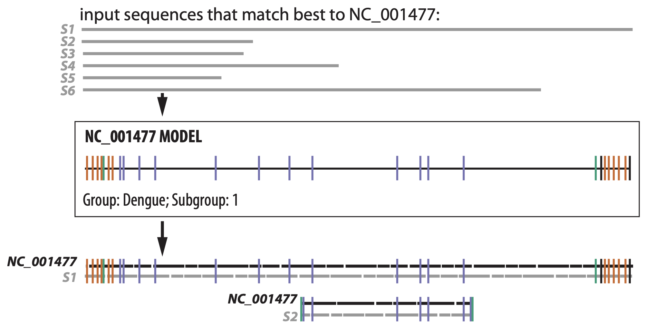
Stage 3: Alignment and feature mapping
Align each sequence to its best-matching model (Infernal's cmalign)

Slide 16
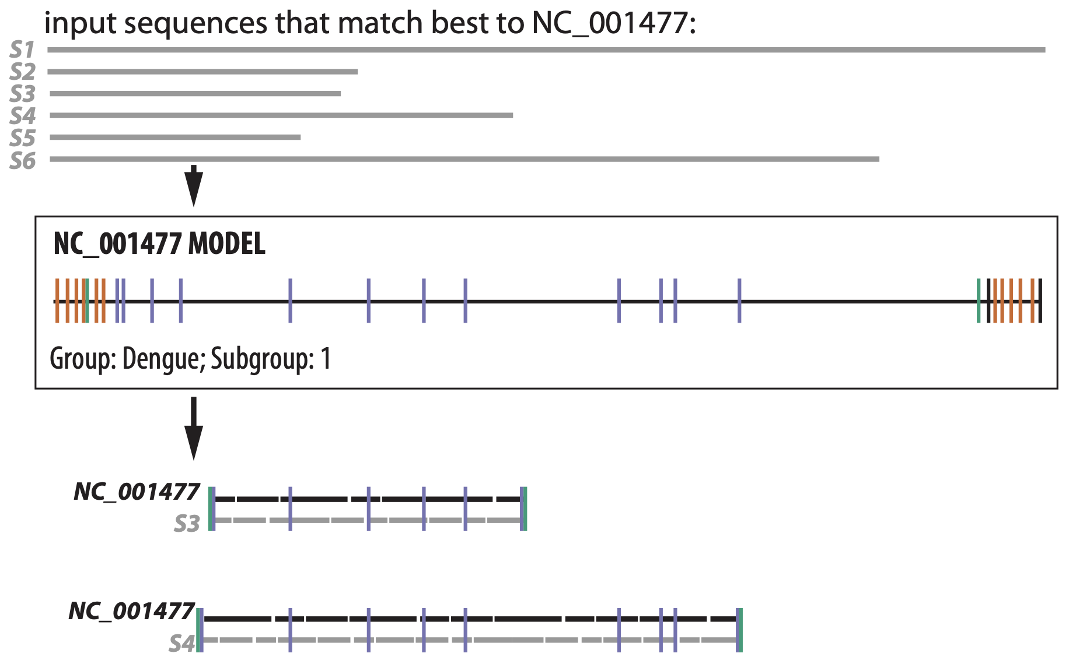
Stage 3: Alignment and feature mapping
Problems caught in coverage determination stage could be missed in alignment stage

Slide 17
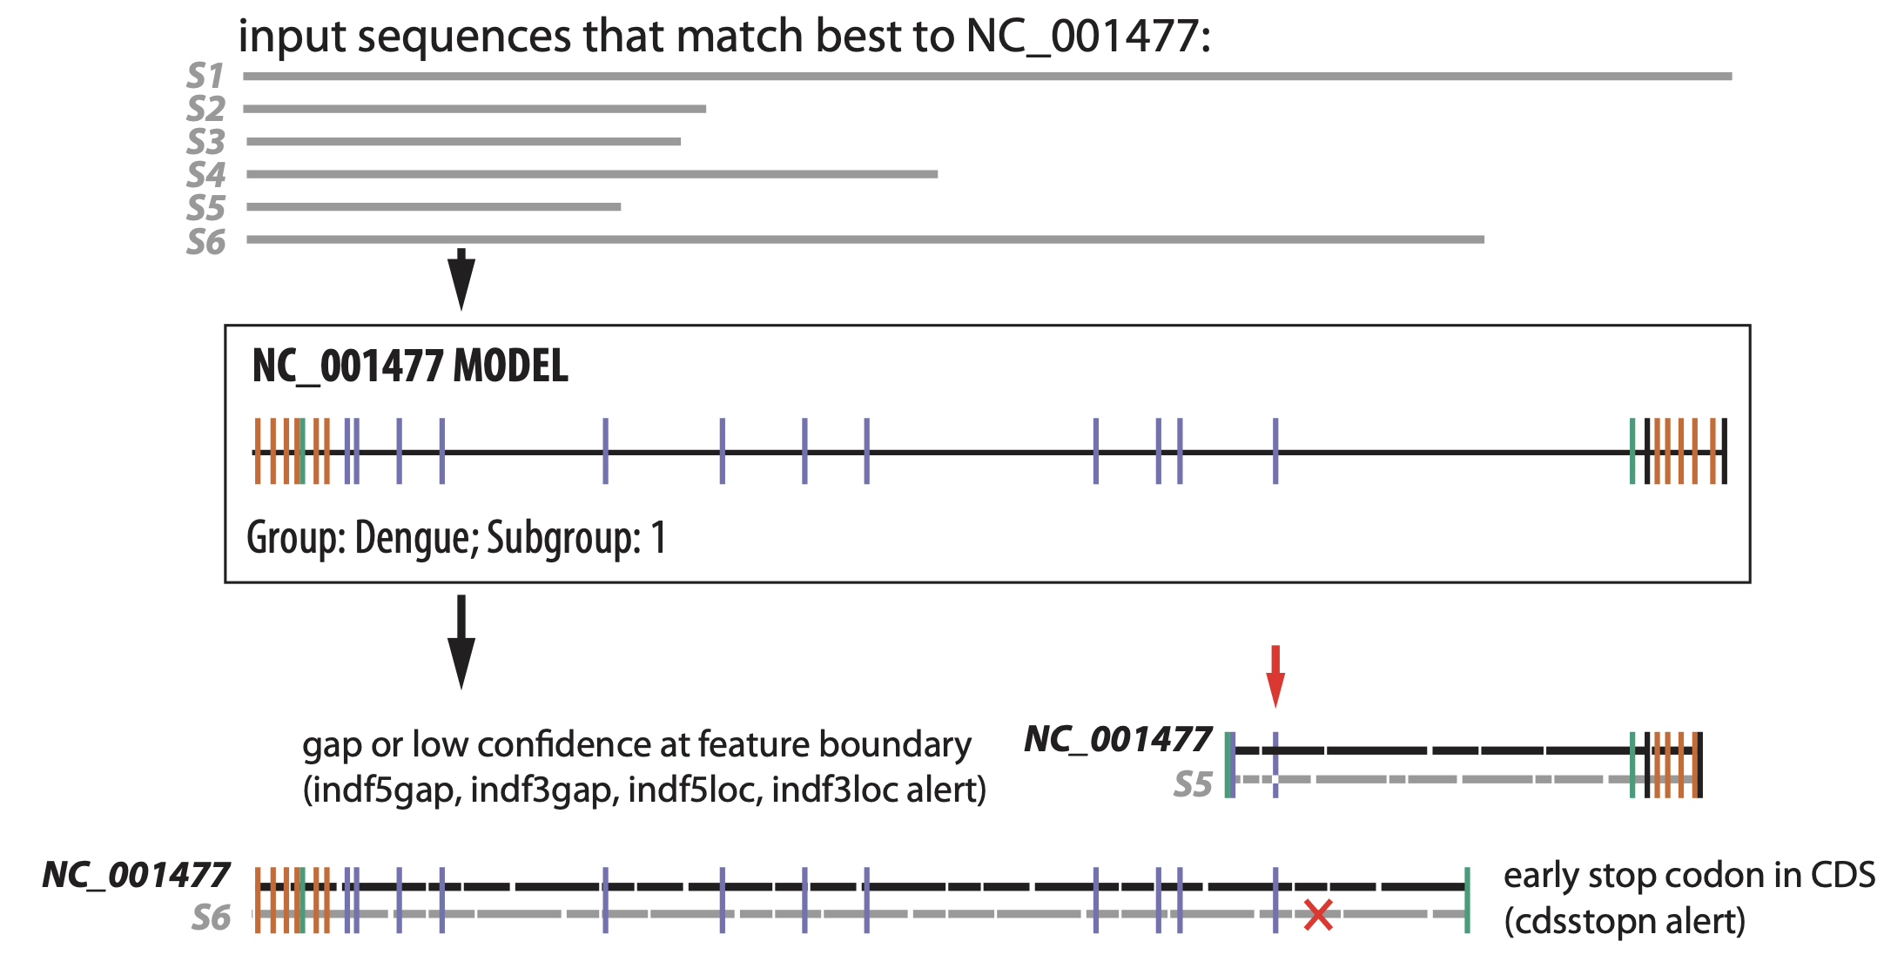
Stage 3: Alignment and feature mapping
Parsing the alignment allows new types of alerts to be detected

Slide 18
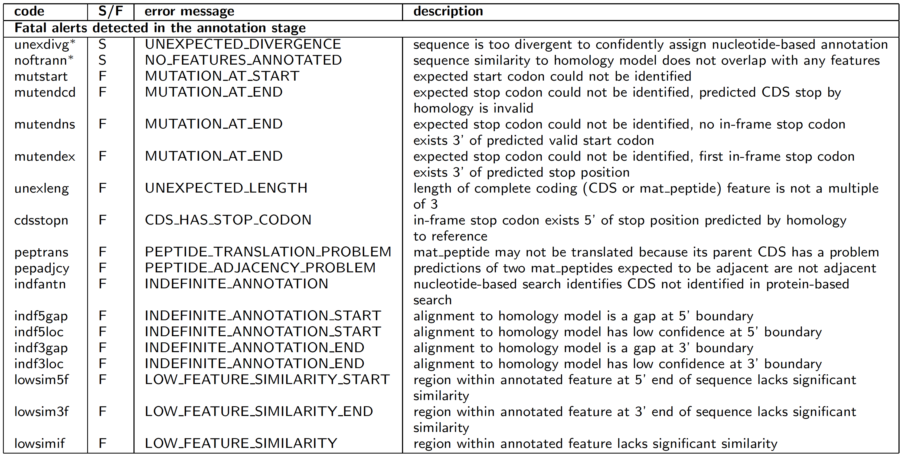
Alerts reported in alignment stage

Slide 19
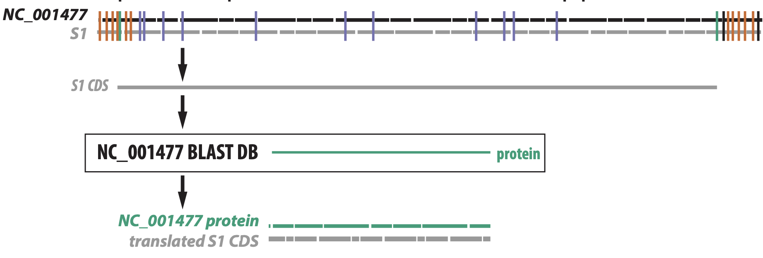
Stage 4: Protein validation (Alejandro Schaffer)
Compare each predicted CDS to model (RefSeq) proteins with BLASTX

Slide 20
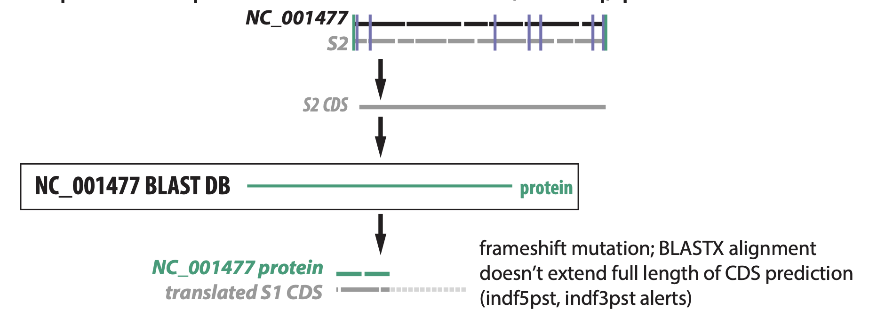
Stage 4: Protein validation (Alejandro Schaffer)
Compare each predicted CDS to model (RefSeq) proteins with BLASTX

Slide 21
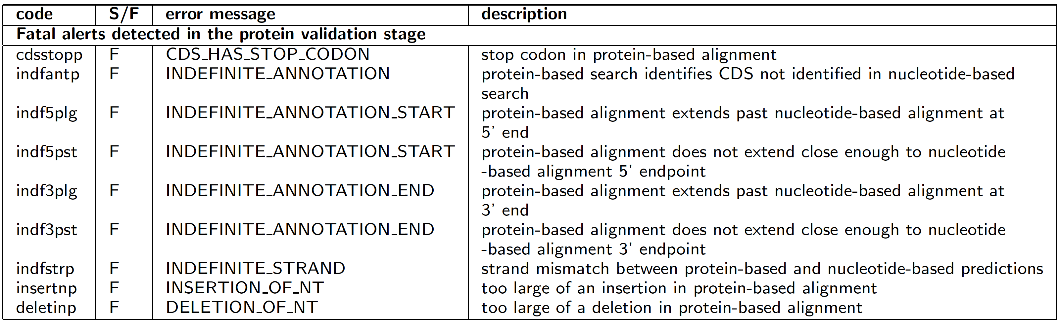
Alerts reported in protein validation stage

Slide 22
Enhancements for SARS-CoV-2 analysis
- Acceleration based on a blastn alignment, reduces processing time from several minutes to 2s per typical sequence
- Replacement of stretches of Ns with 'expected' nucleotides from the RefSeq when possible
STATS ON NUMBER OF Ns in SEQS

Slide 23
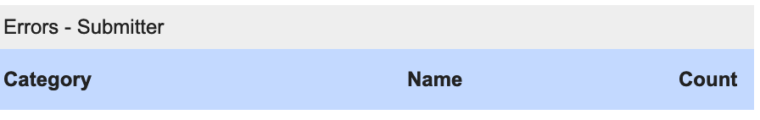
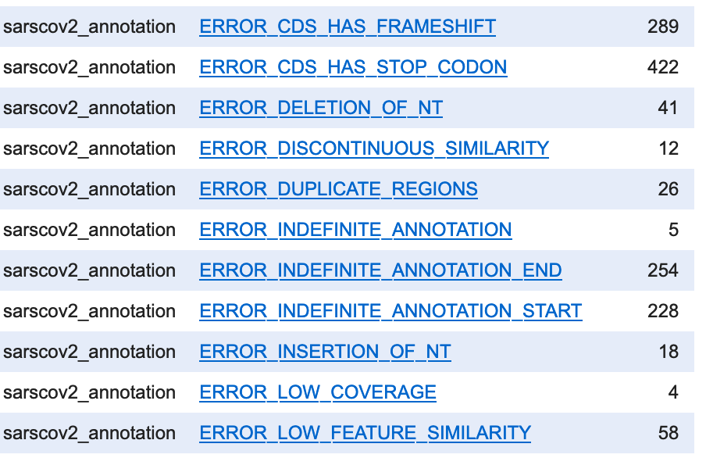
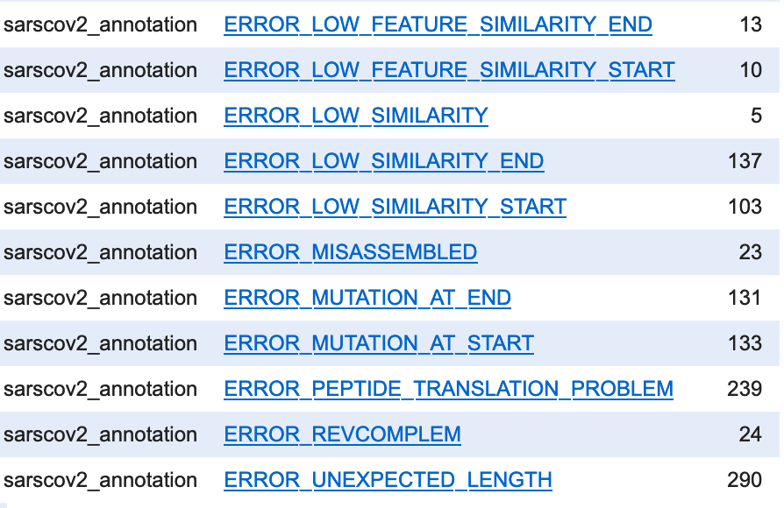
Fatal alert counts for SARS-CoV-2

Slide 24
Examples of SARS-CoV-2 failures
TODO

Slide 25
Limitations
- makes inferences in nucleotide space, not protein space
- model (RefSeq) must be representative
- divergent sequences, novel stop codons, etc. are problematic
- requires 64Gb of RAM (!) for some SARS-CoV-2 sequences

Slide 26
Important features of VADR
- PASS/FAIL decision for each sequence
- gives indexer/user control over fatal/non-fatal alert designations and, in many cases, thresholds
- informative alert messages
- general tool applicable to any virus (but performance is dependent on sequence diversity)
- models features as short as a single nucleotide, potentially multiple 'segments'

Slide 27
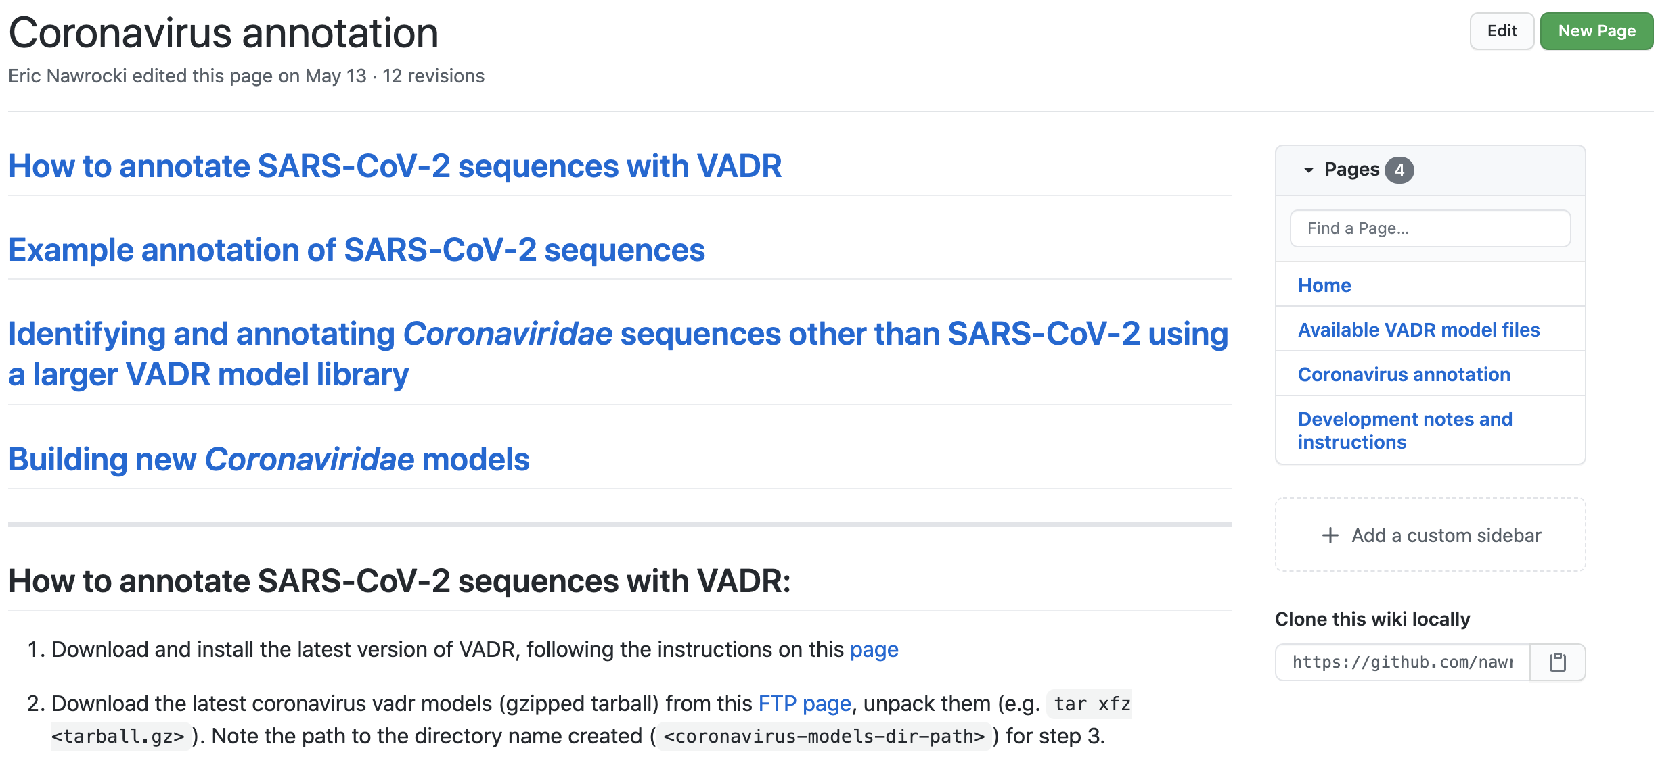
VADR is documented on GitHub
- https://github.com/nawrockie/vadr/wiki/Coronavirus-annotation

Slide 28
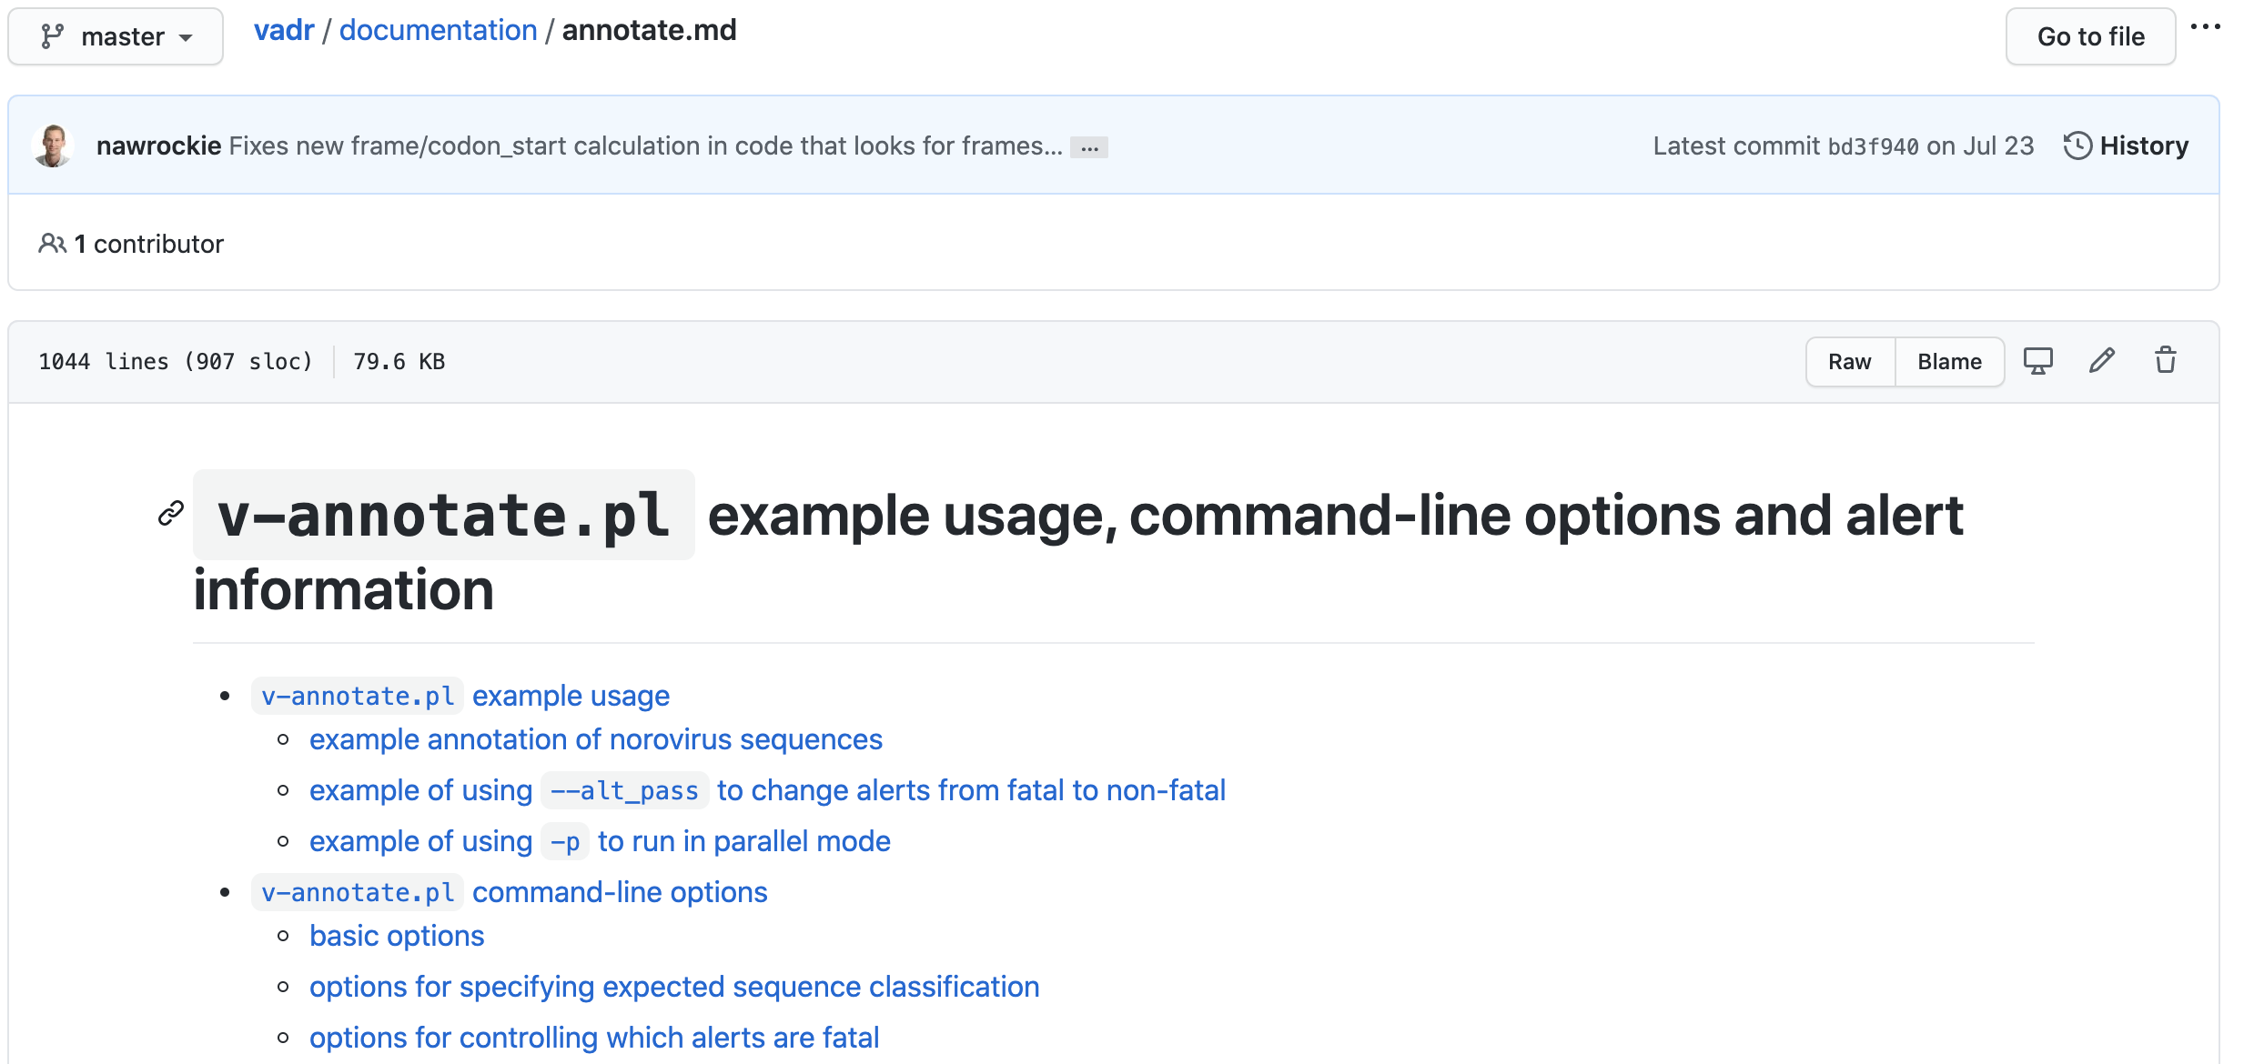
VADR is documented on GitHub
- https://github.com/nawrockie/vadr/blob/master/documentation/annotate.md

Slide 29
Appendix slides

Slide 30
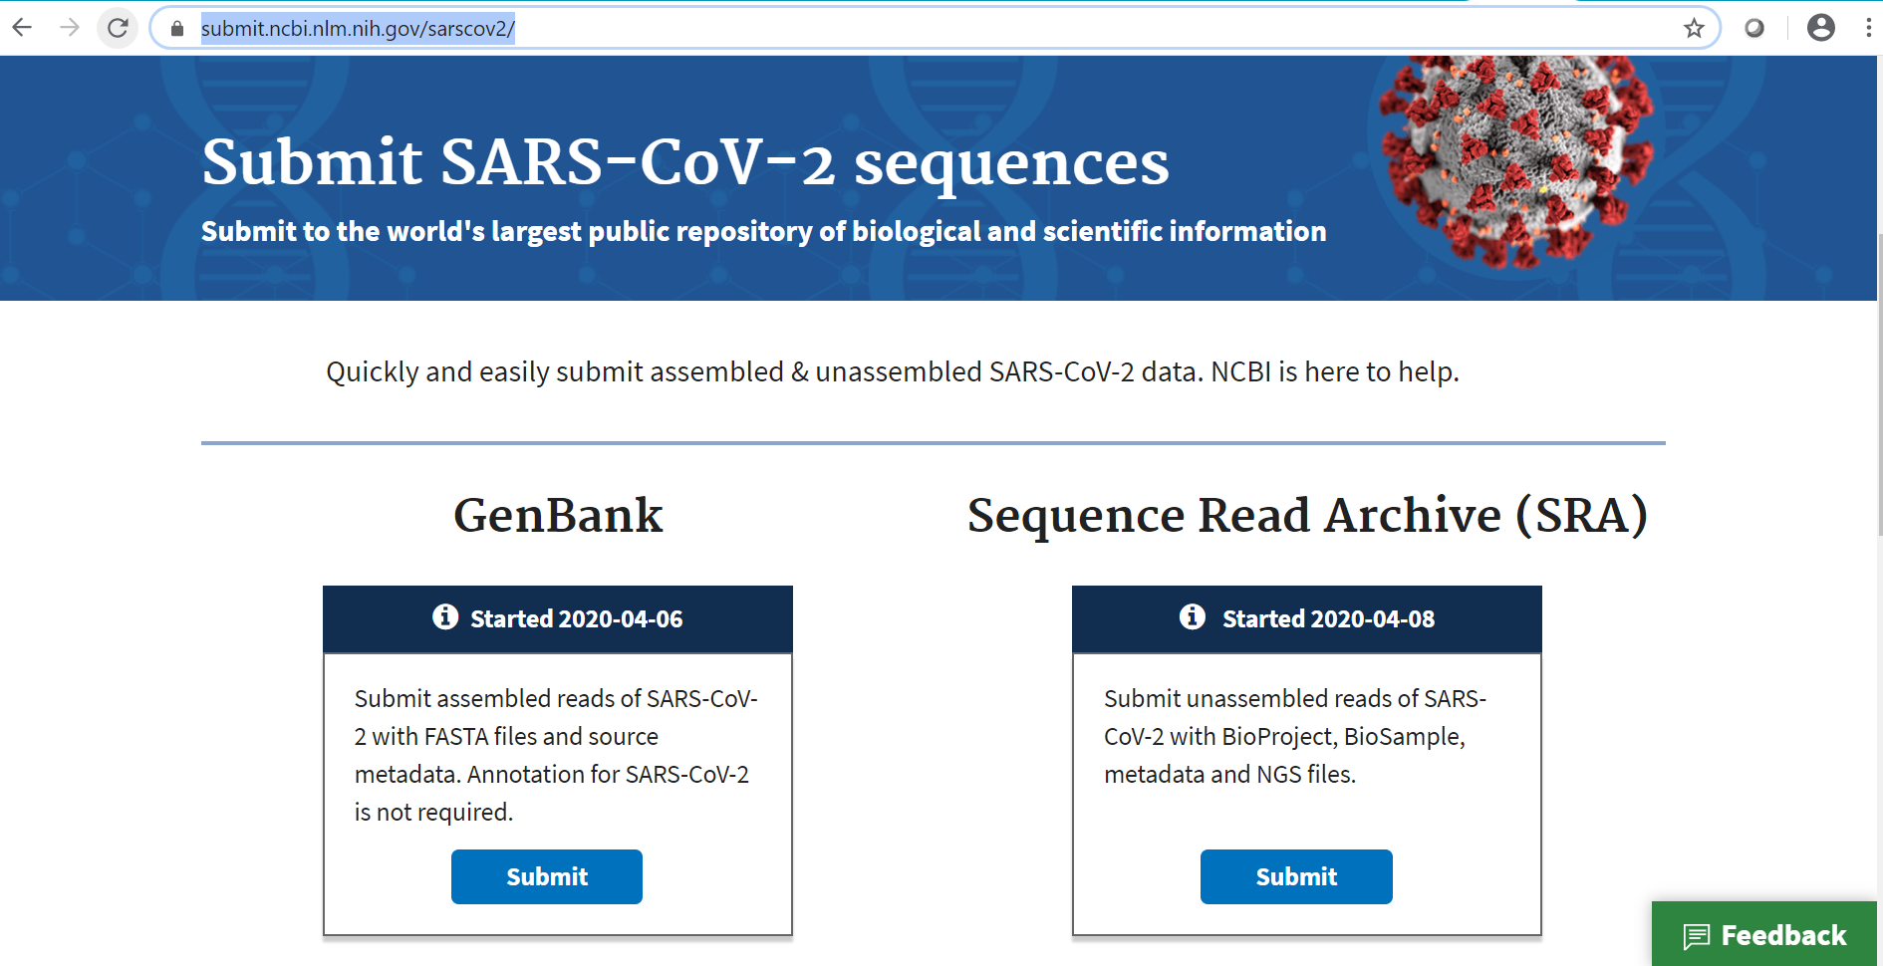
Single starting point
submit.ncbi.nlm.nih.gov/sarscov2

Slide 31
GenBank - assembled reads
How to submit
Prepare FASTA file and source metadata
Use NCBI’s online wizard
Annotation for SARS-CoV-2 is not required – we’ll do it for you
Use “Severe acute respiratory syndrome coronavirus 2” as the organism name to expedite submission processing
Accessioning & editing
Accessions issued and data released within ~1-2 working days (unless there are unresolved issues with the submission)
Contact gb-admin@ncbi.nlm.nih.gov for data fixes post-submission

Slide 32
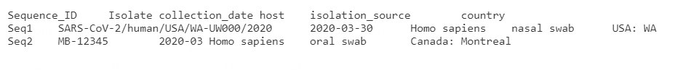
Source table
Two approaches
Metadata can be uploaded from a tab-delimited table; OR,
Add your data through an editable table (Coming soon!)
Two formats are supported

Slide 33
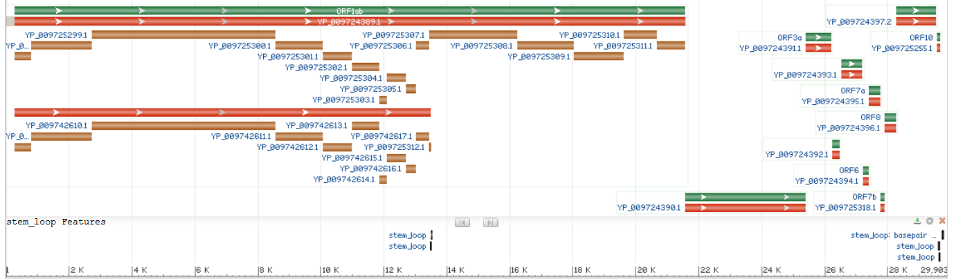
NCBI annotation approach
VADR: reference-based annotation tool
Annotates genes, CDSs, mature peptides, and 5 stem-loops
QC checks such as indels in ORFs, strings of N's, sequence which is dissimilar from RefSeq (NC_045512)
VADR is available on GitHub https://github.com/nawrockie/vadr

Slide 34
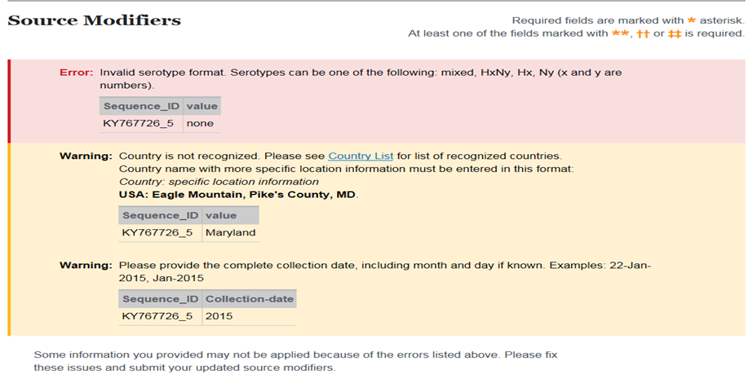
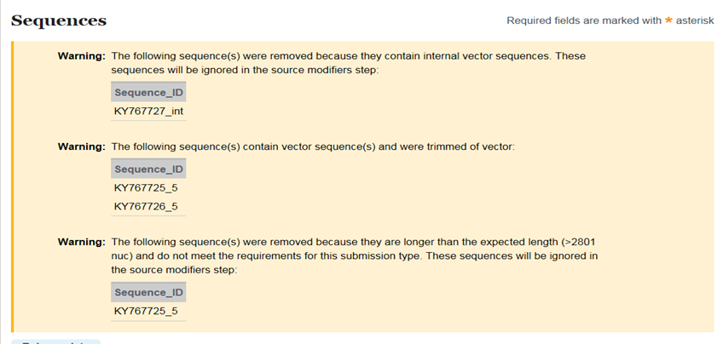
Validations & reporting

Slide 35
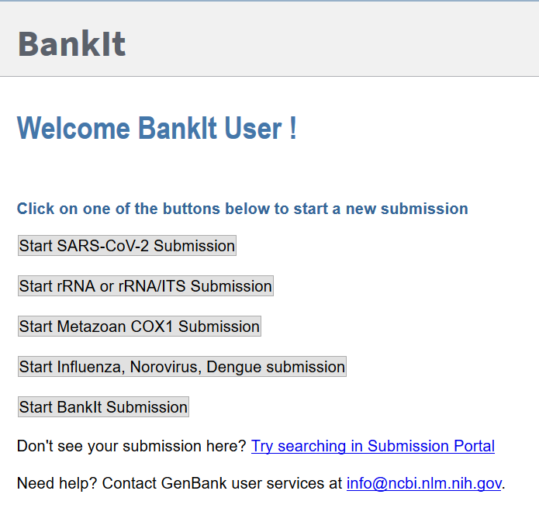
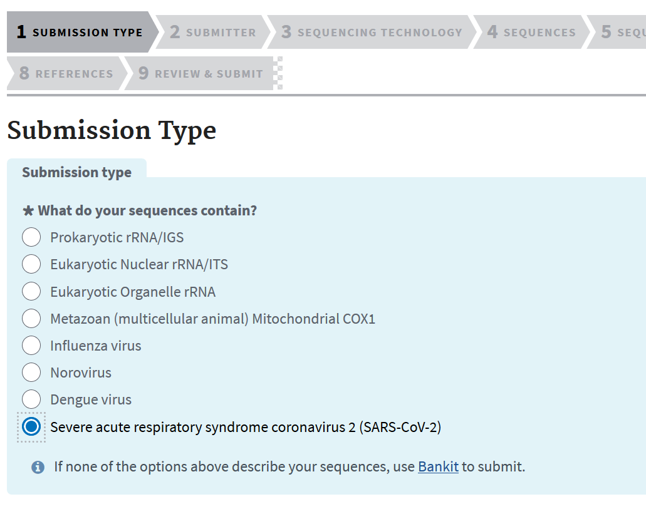
Getting started
submit.ncbi.nlm.nih.gov/sarscov2
Submitting today
Coming soon! (Mid-May)

Slide 36
SRA – raw reads
How to submit
Prepare metadata and NGS files
Follow step-by-step instructions on the web or use an API
Variety of upload options: Aspera, from AWS bucket, browser
Accessioning & editing
Accessions within ~2 - 4 hours
‘Manage data’ on an easy-to-use web interface
Release your data, edit metadata, publications, grants & more
Contact sra@ncbi.nlm.nih.gov if you prefer programmatic submissions

Slide 37
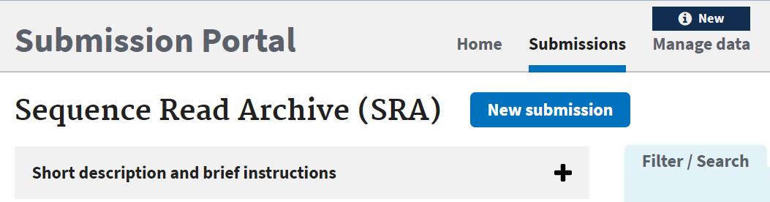
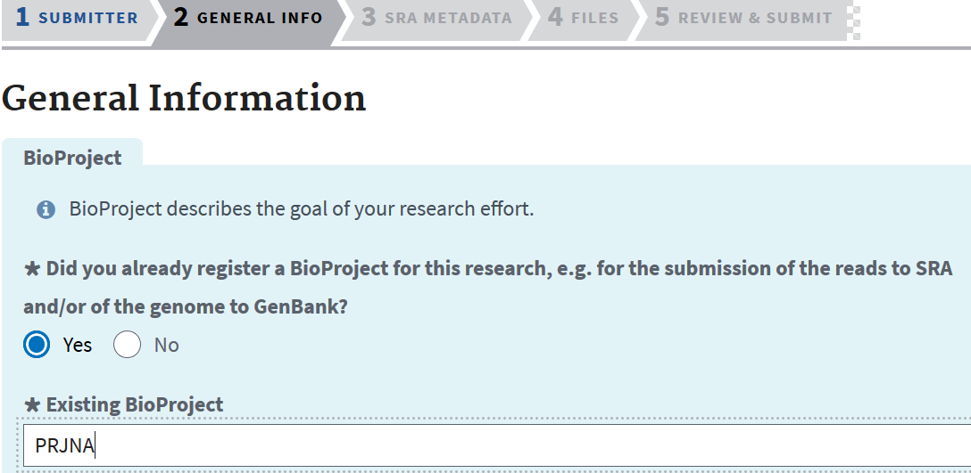
Start with the basics
Log in to NCBI
Start 'New submission'
Follow the prompts
Verify your information
No BioProject or BioSample yet? No problem – create them right in the workflow
Opt to release immediately or HUP

Slide 38
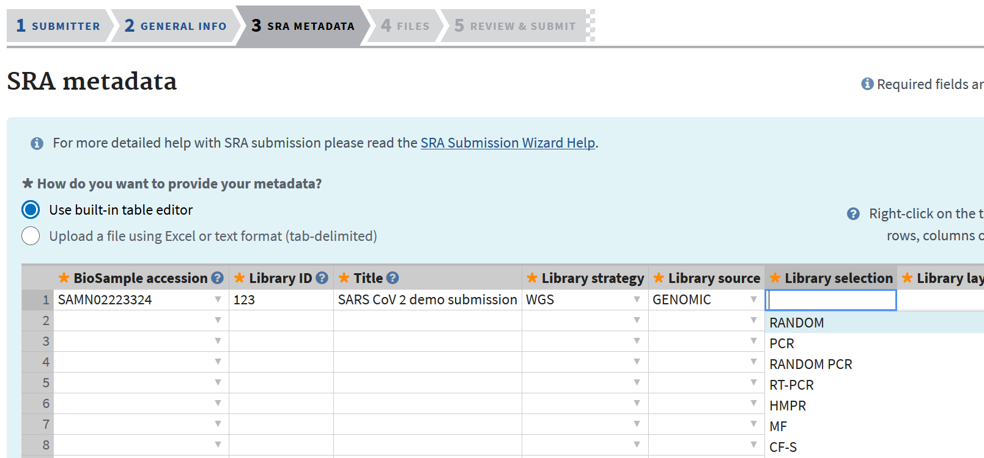
Two options for metadata entry

Slide 39
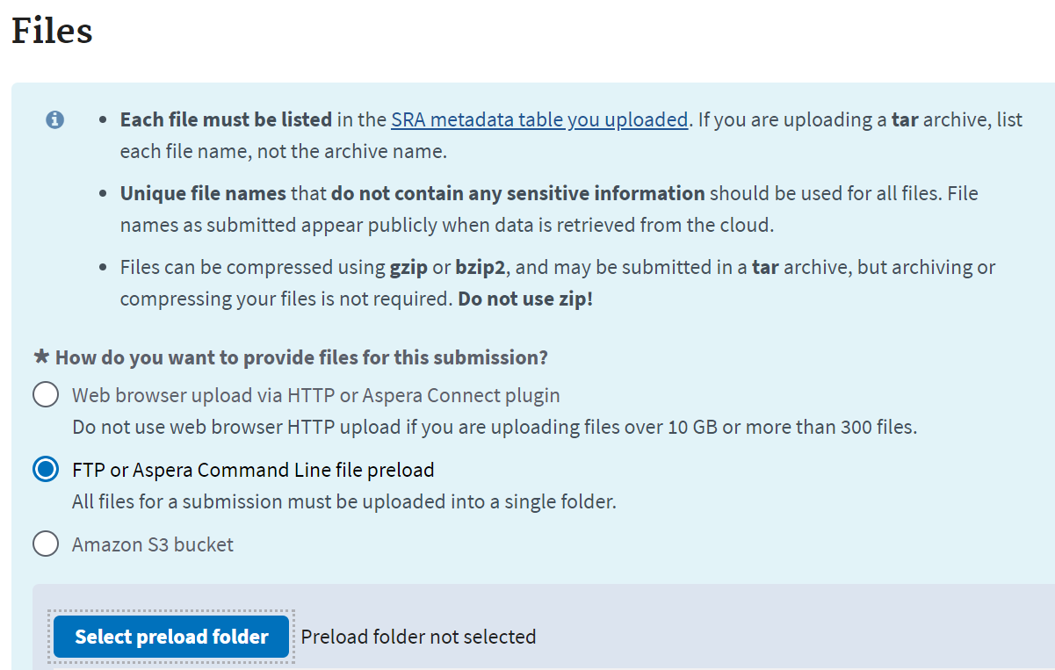
Uploading files
Preload folder ideal for large volume uploads
Upload directly from an AWS bucket
Use web browser or Aspera if files are <10 GB or less than 300

Slide 40
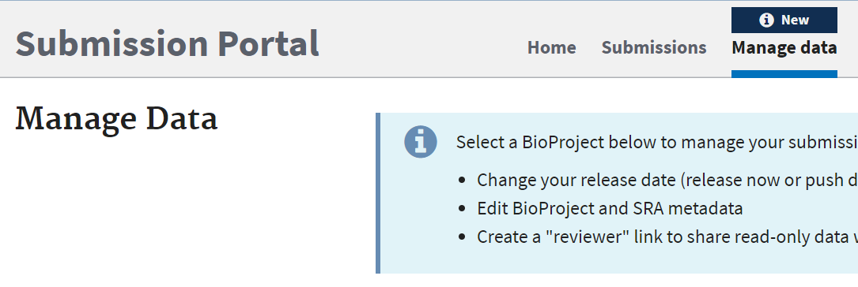
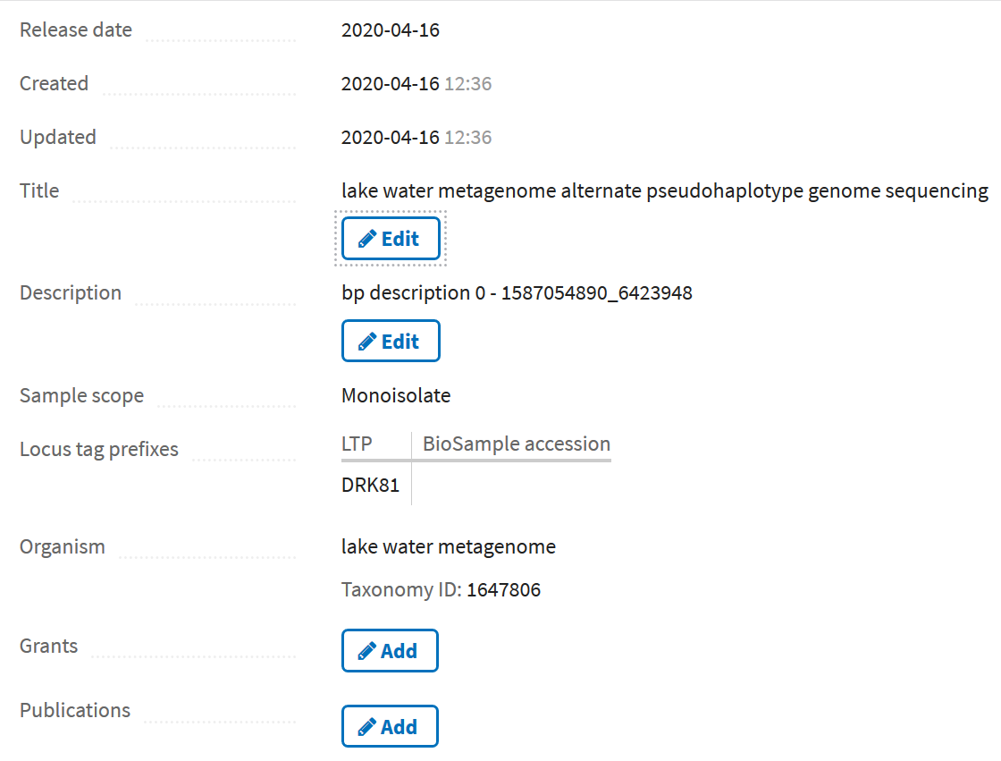
Managing your submission
dataview.ncbi.nlm.nih.gov
Self-service options:
Edit or add BioProject and SRA metadata
"Release now" or delay release
Share this content in read-only form, pre-release

Slide 41
New features & enhancements
Submission enhancements
Faster turnaround & improved experience for GenBank submitters
New GenBank API submission options
Programmatic option under construction
NCBI COVID-19 Portal
Additional references
Contact us if you think additional RefSeqs are needed to represent diverse lineages

Slide 42
Help
NCBI is here to help with your submission
GenBank gb-admin@ncbi.nlm.nih.gov
SRA sra@ncbi.nlm.nih.gov
VADR resources on GitHub https://github.com/nawrockie/vadr
RefSeq
Send feedback on RefSeq NC_045512 to Eneida.Hatcher@nih.gov

Slide 43

Q&A
This Photo by Unnown author is licensed under CC BY-NC.

